Slide 1



Voice-Enabled AI Chatbot with Context Awareness in LMS
Individual Reflection Syeda Tamanna Sheme
Role: Frontend Developer & Tester
Client: Employability.Life
Client Name: Neeraj Singh
Client contact details NSingh@employability.life

Slide 2
Project Overview
Key Objectives
Automate common queries and tasks within Moodle through natural language.
Provide personalized assistance to users based on their roles (Student, Instructor).
Integrate seamlessly with Moodle UI for real-time interaction.
Core Features
Role-Based Intelligence
Conversational Access to LMS Data
Course & Assignment Management
Voice & Text Enabled
UI Integration
Secure & Modular Architecture

Slide 3
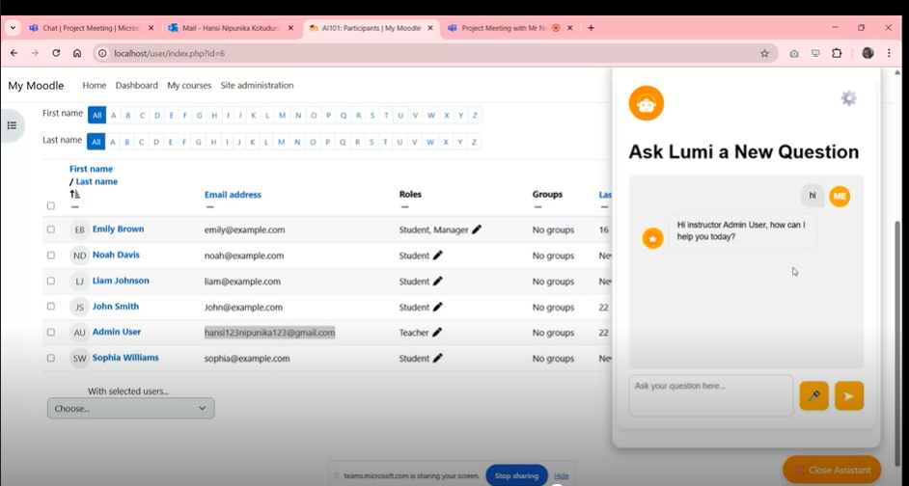
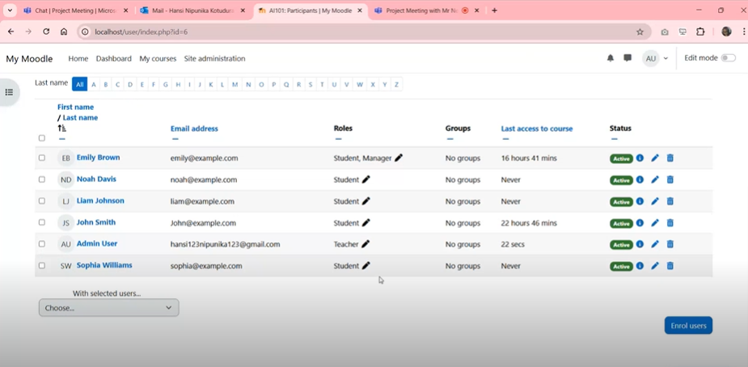
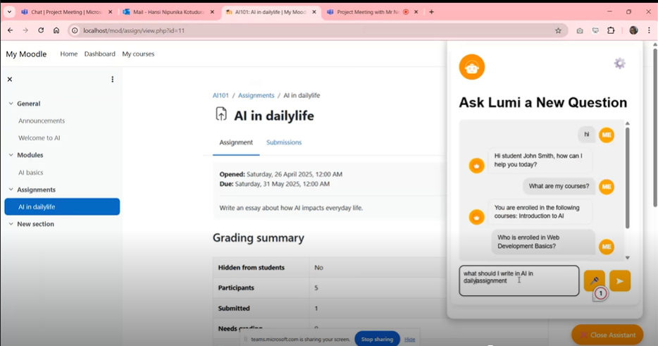
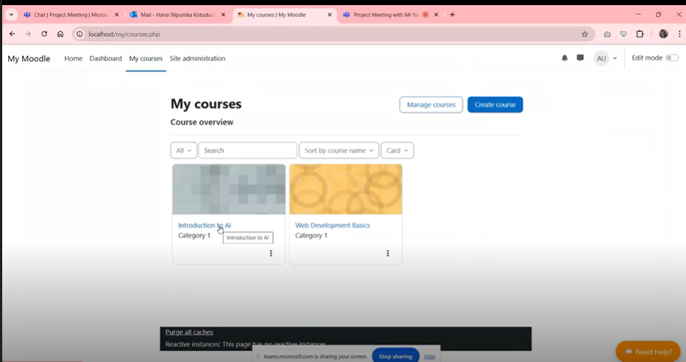
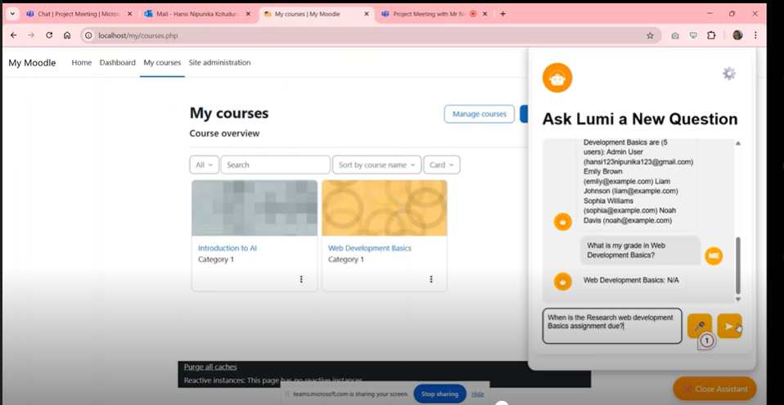
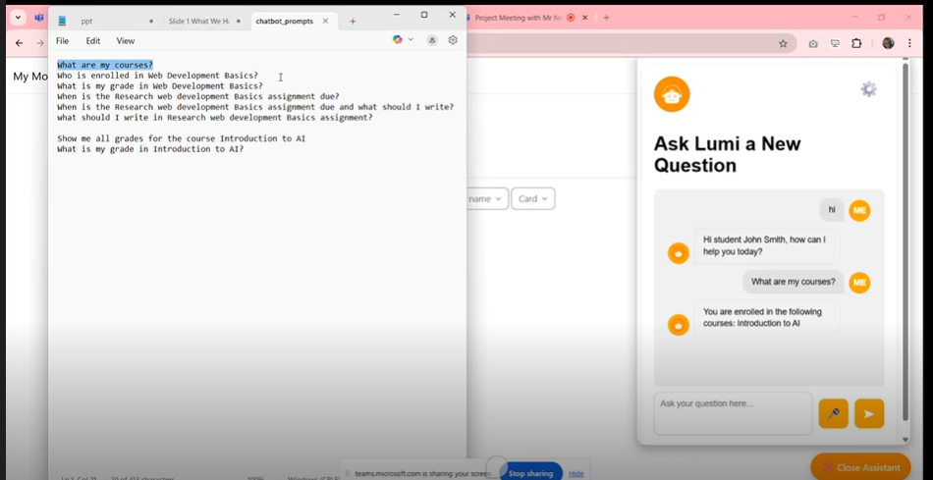
Project Overview

Slide 4
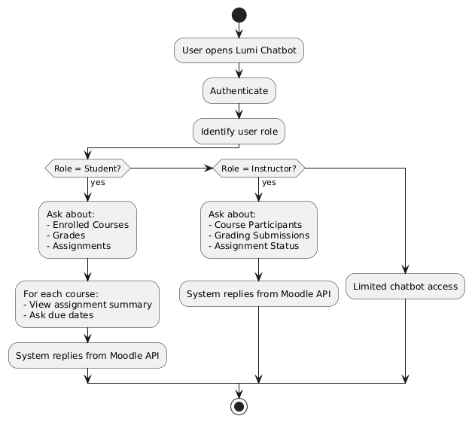
Role-Based Interaction Flow

Slide 5
What I Built, Tested, and Delivered
Role: Frontend Developer & QA Tester.
Designed & developed UI components for over 13 key pages.
Led Testing Initiatives:
Manual Testing on all pages
Automated Testing using Jest
Test planning and execution in TestRail
Issue tracking in Jira
Code & Documentation Management:
GitHub for source control & collaboration
Confluence for detailed documentation

Slide 6

Tech Stack That Powered My Work
Design & Prototyping : Figma – Used for wireframe creation and UI planning
Frontend Development : HTML5, CSS3, Bootstrap, JavaScript
Testing Frameworks
Jest – Automated unit tests for UI components
TestRail – Manual and Automation test cases creation, execution, and tracking
📂 Project Management & Collaboration
Jira – Sprint planning, backlog refinement
GitHub – Version control, PRs, issue tracking
Confluence – Team documentation
🛠️ Development Environment: VS Code with Extensions:
Prettier (code formatter)
Live Server (real-time preview)
ESLint (linting support)
GitLens (Git insights)
Jest Runner (test execution)

Slide 7
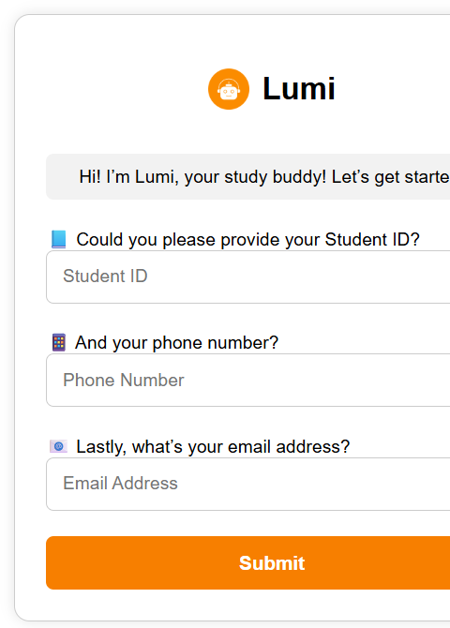
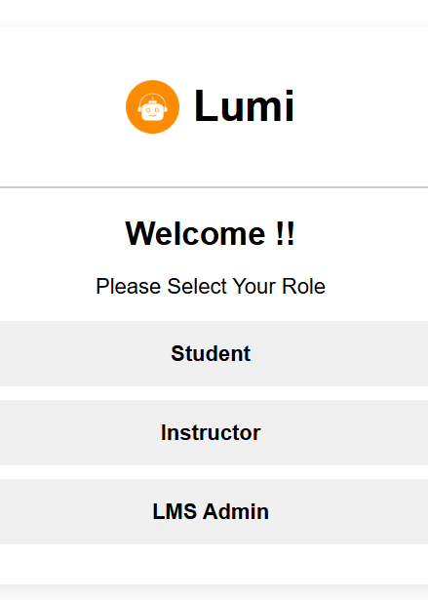
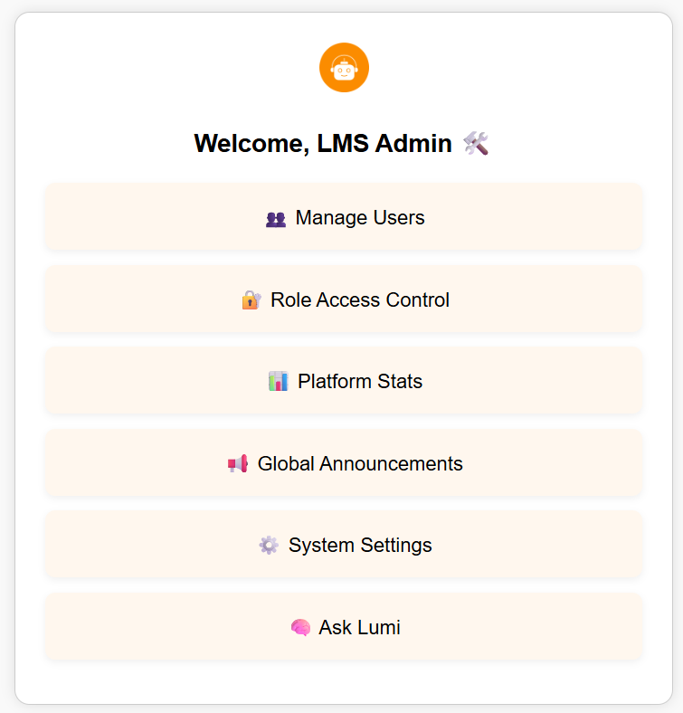
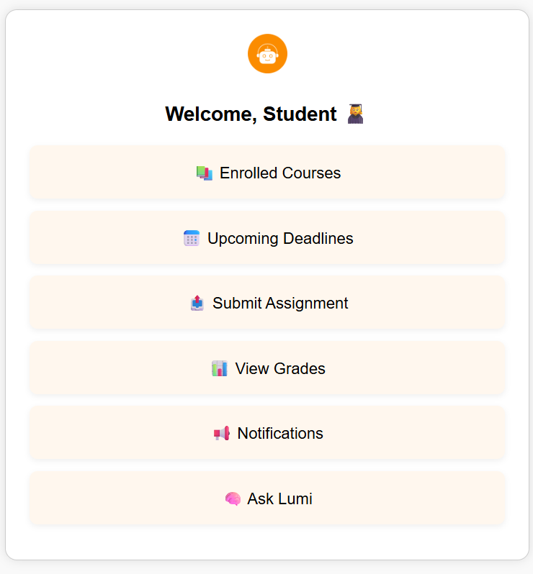
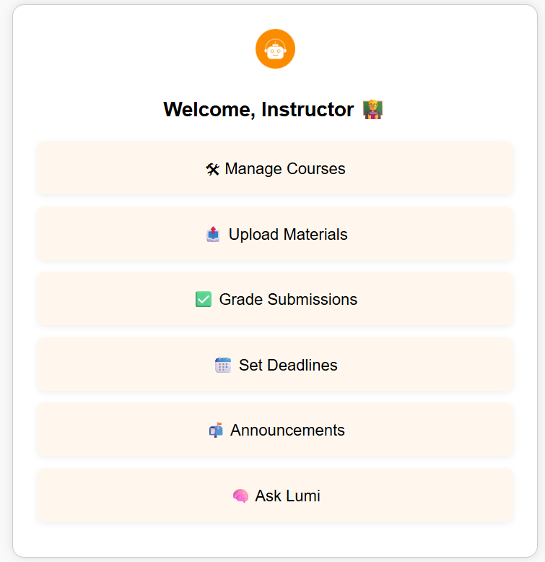
UI - Wireframes

Slide 8
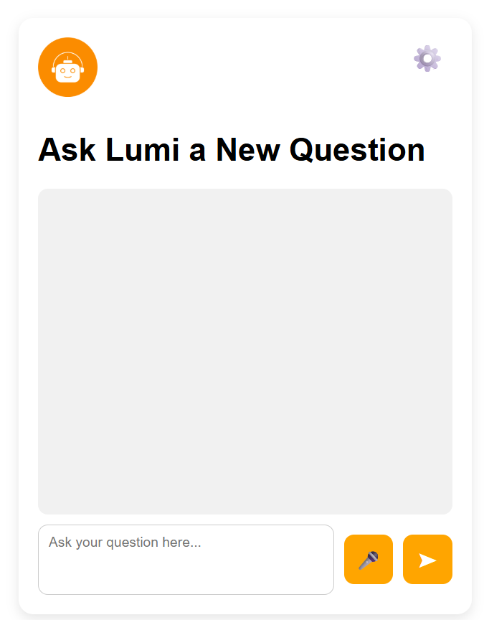
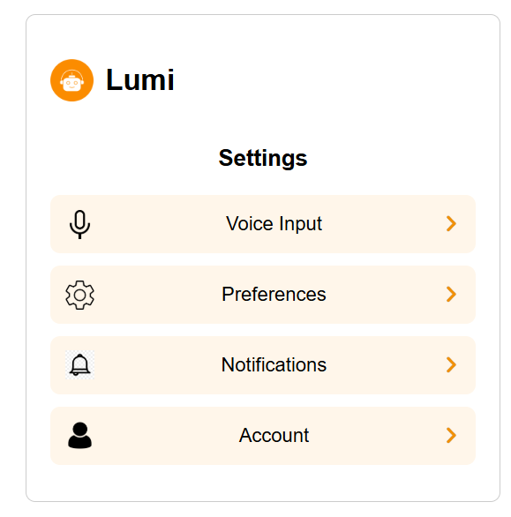
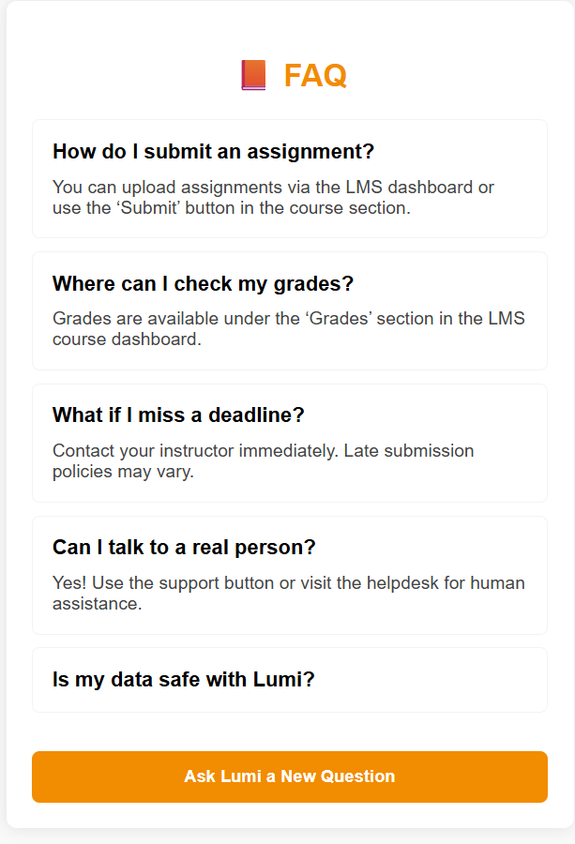
UI - Wireframes

Slide 9
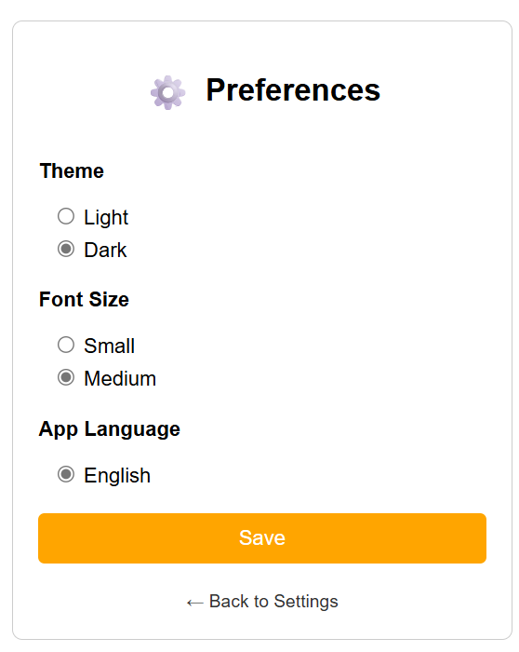
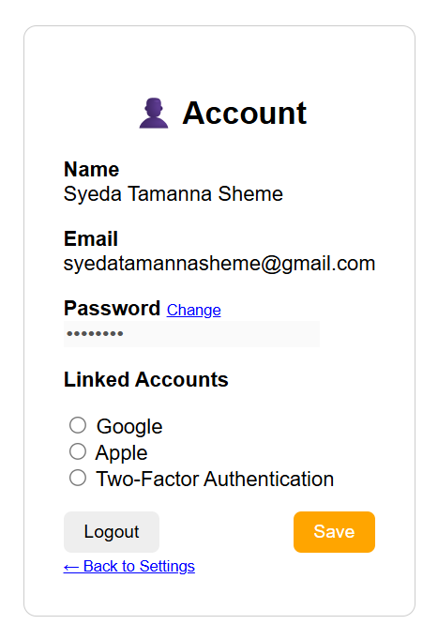
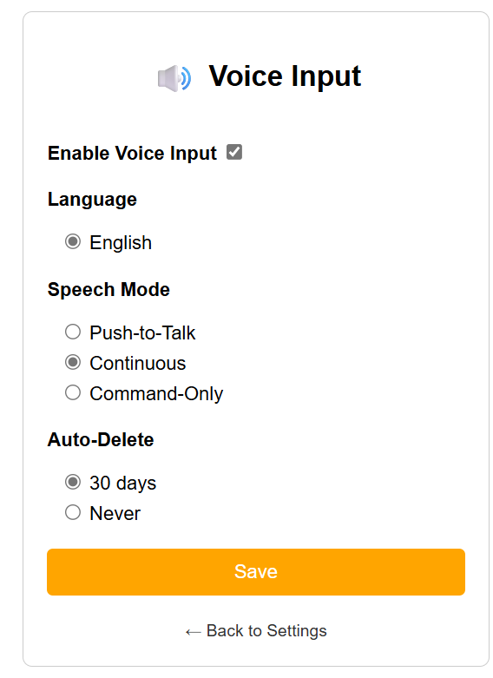
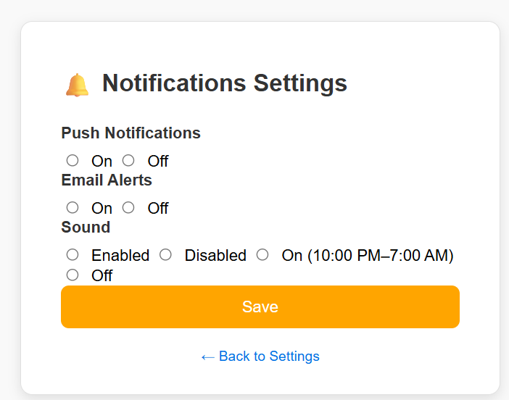
UI - Wireframes

Slide 10
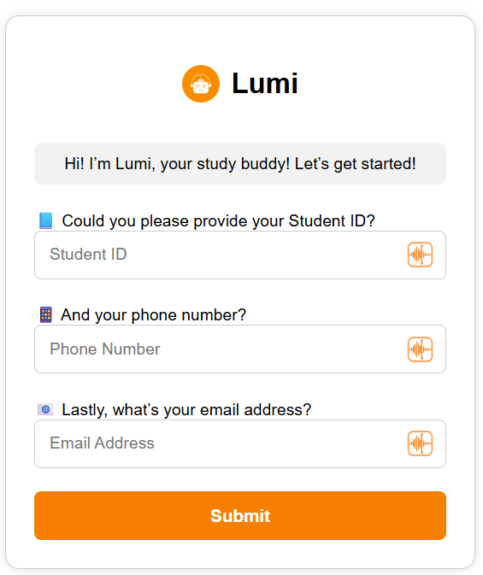
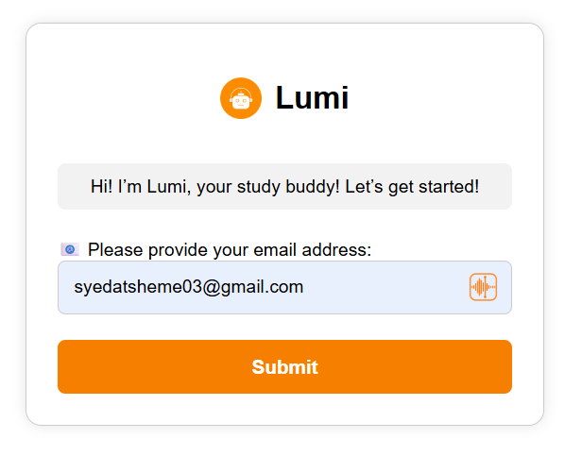
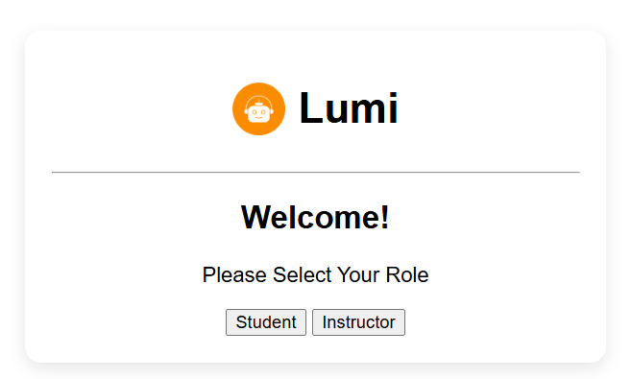
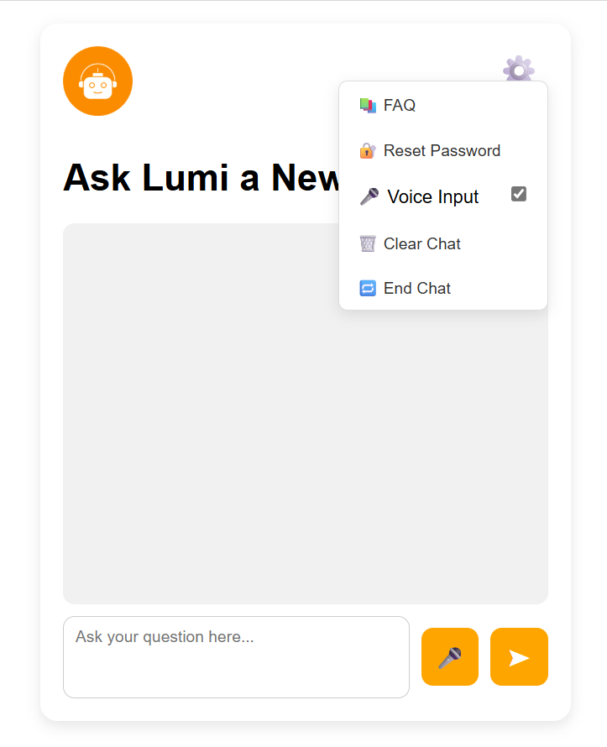
Enhanced Wireframes

Slide 11
Manual Testing

Slide 12
Introduction To TestRail
What is TestRail? - A web-based test case management tool used by QA teams to manage, organize, and track software testing.
Why use it for test management?
Centralized repository for manual and automated tests
Integrates easily with tools like Jira, Jenkins, and CI/CD pipelines
Tracks execution, results, and test history
Supports Agile workflows and collaboration

Slide 13
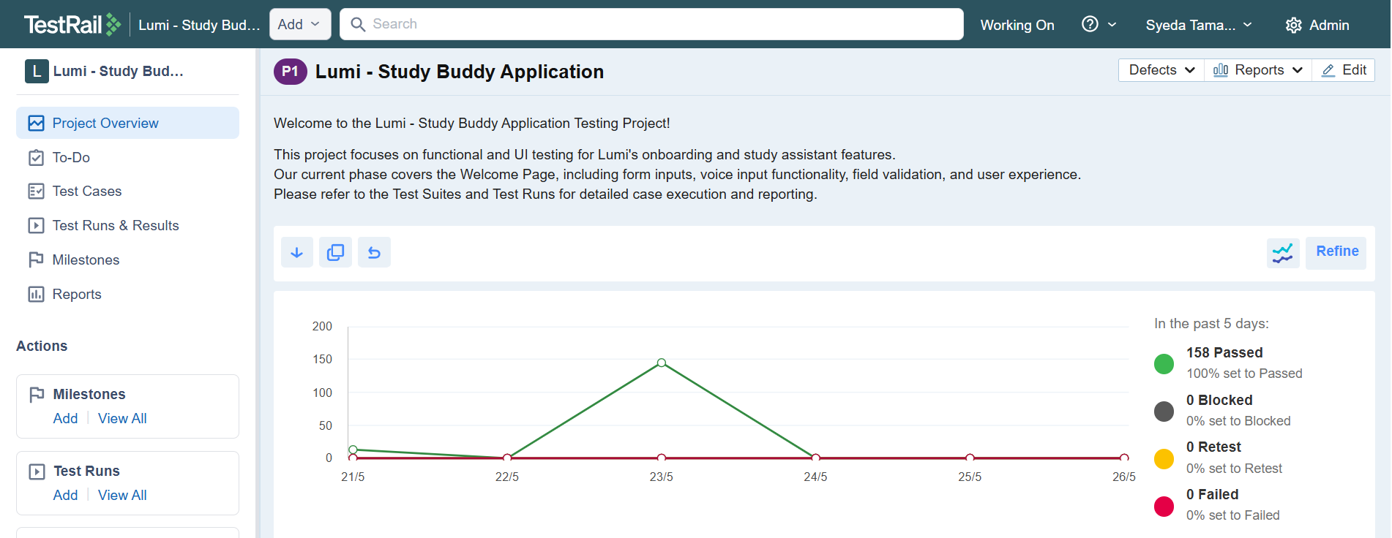
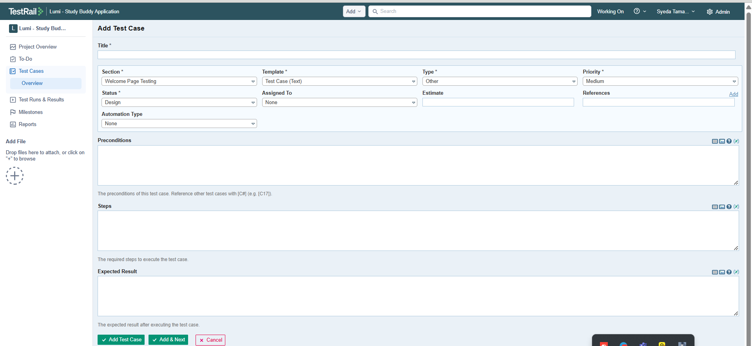
Creating Test Cases

Slide 14
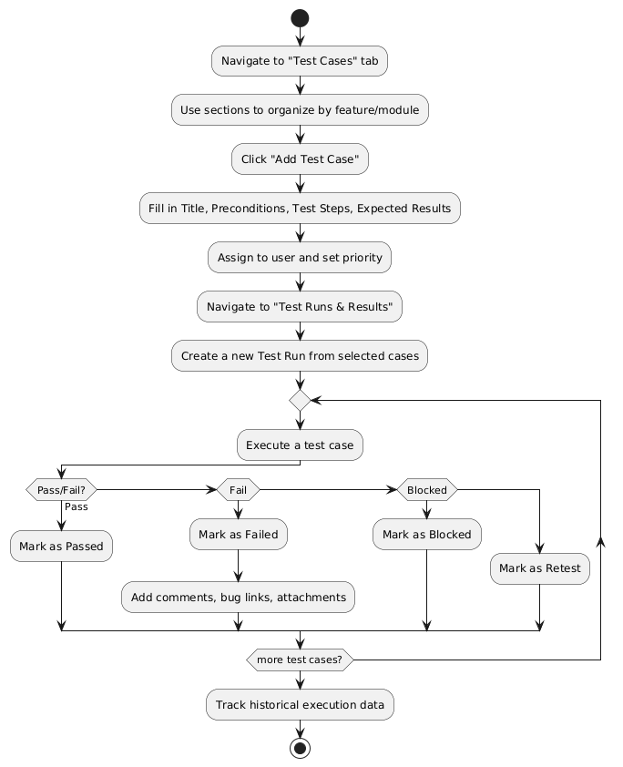
TestRail Workflow: From Test Case Creation To Execution

Slide 15
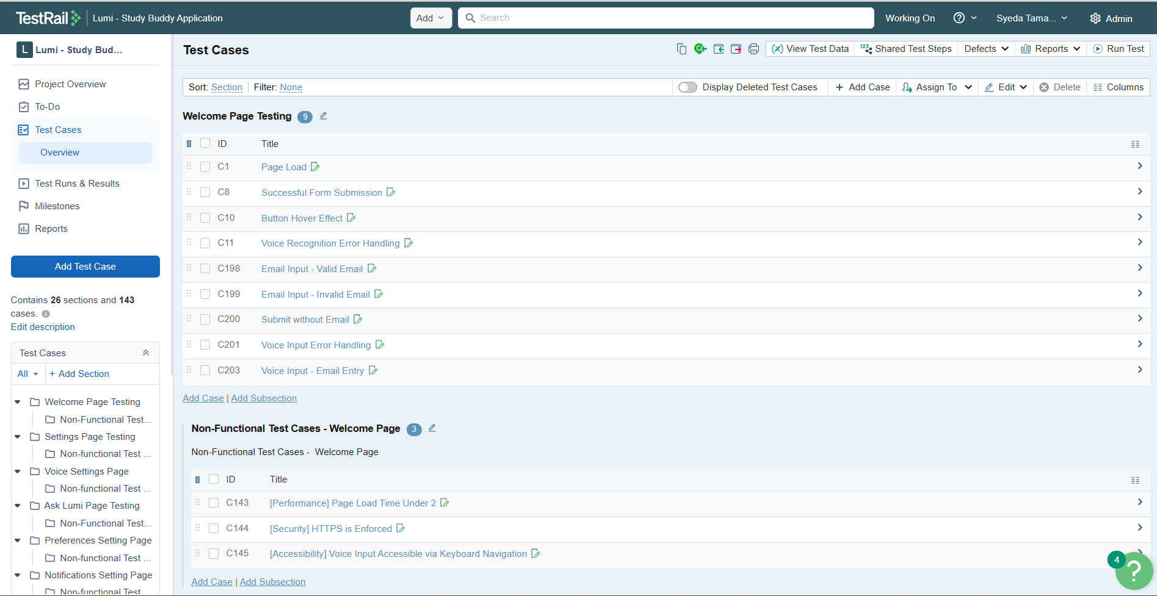
Test Cases

Slide 16
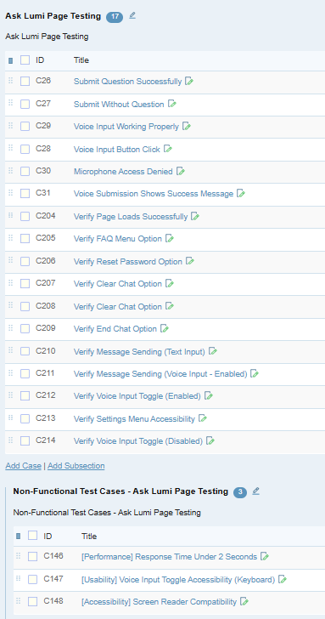
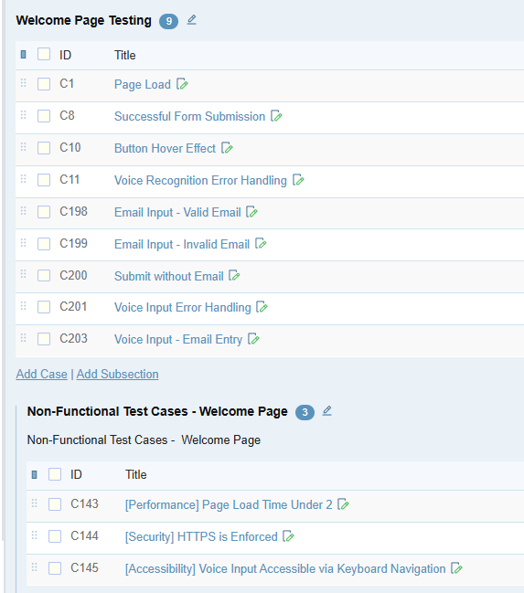
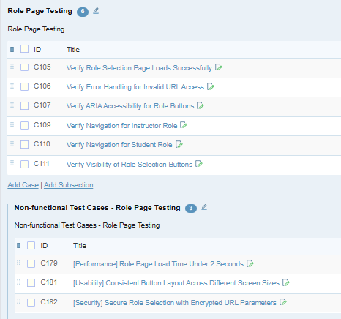
Test Cases In Test Rail
Test Rail Test Case Report: https://drive.google.com/file/d/1sDyVEi-_MntK-1LeIjt_OlNjqbVsbi9a/view?usp=drive_link

Slide 17
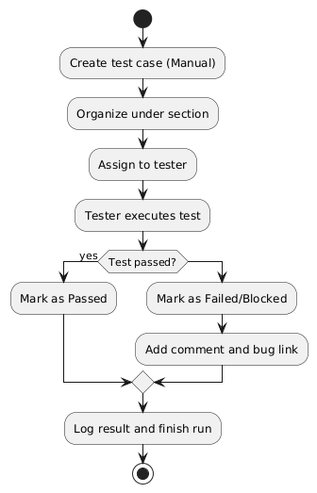
Manual Testing In TestRail
Create structured test cases with step-by-step actions
Organize test cases into sections and suites
Assign test cases to testers for manual execution
Execute tests and record outcomes (Pass/Fail/Blocked/Retest)
Add comments, evidence (screenshots/logs), and bug references
Use test runs to group and track manual testing progress
Review historical execution data for each test case

Slide 18
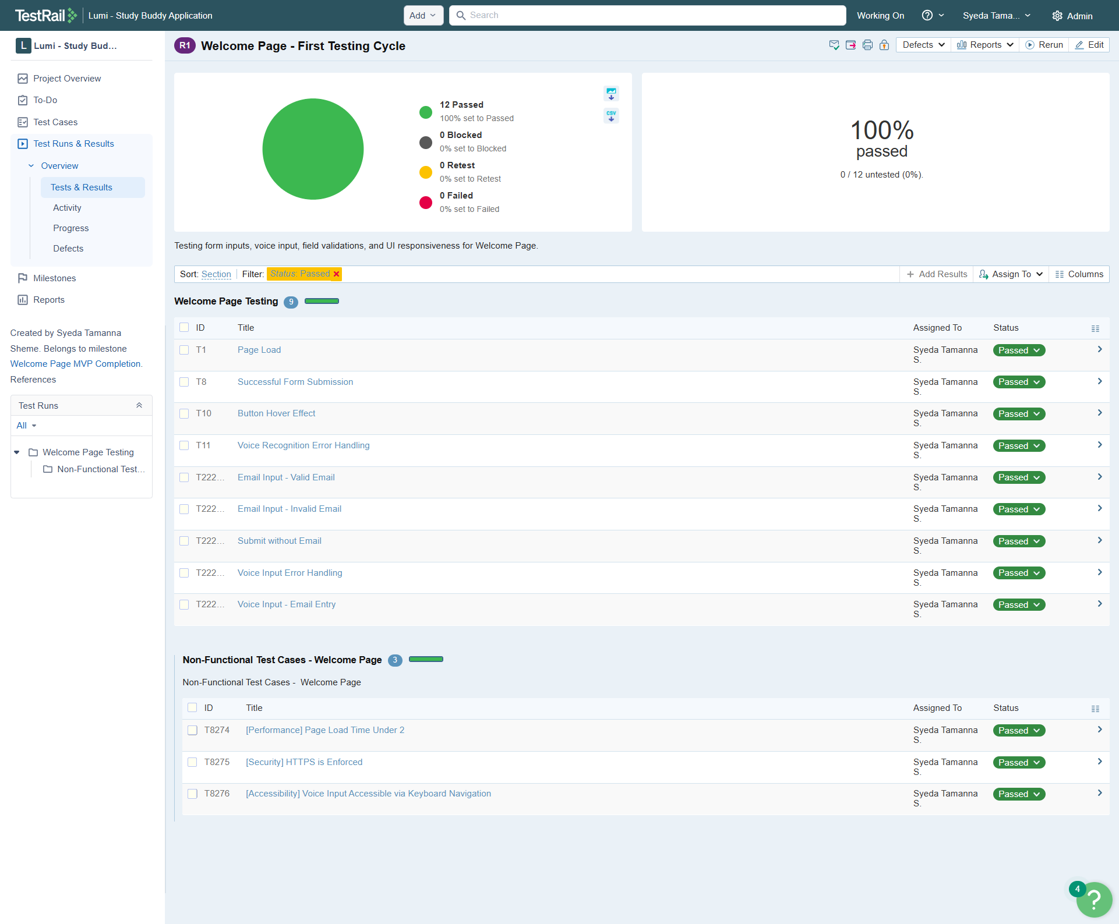
Manual Testing

Slide 19
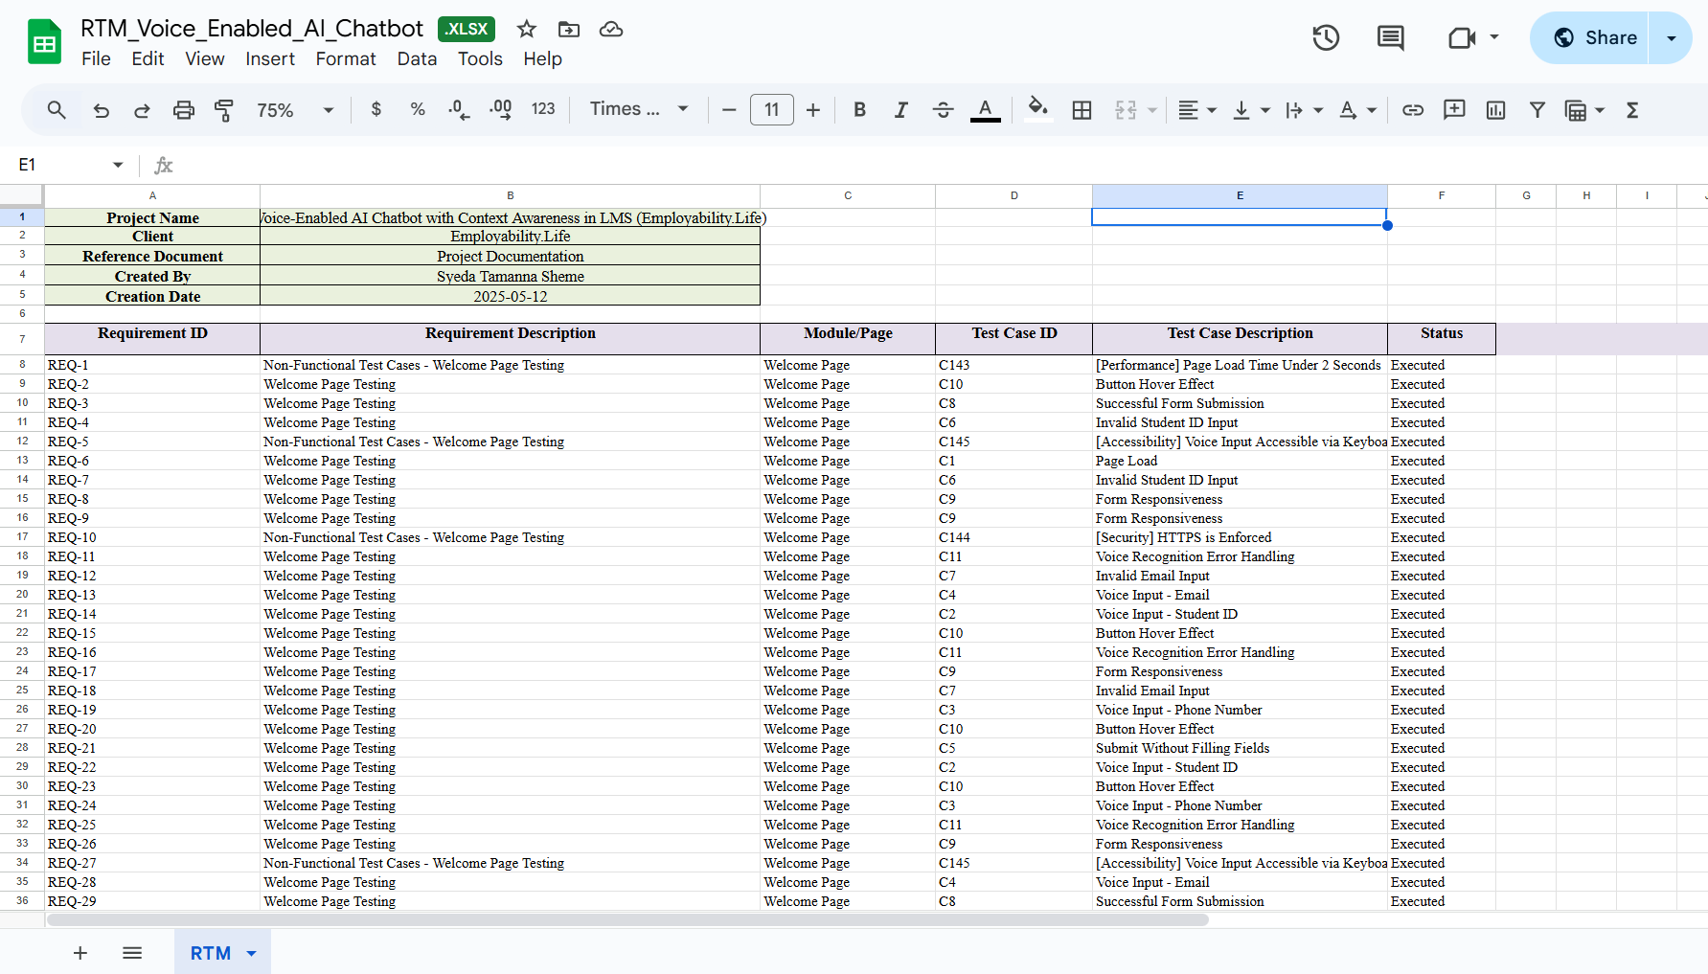
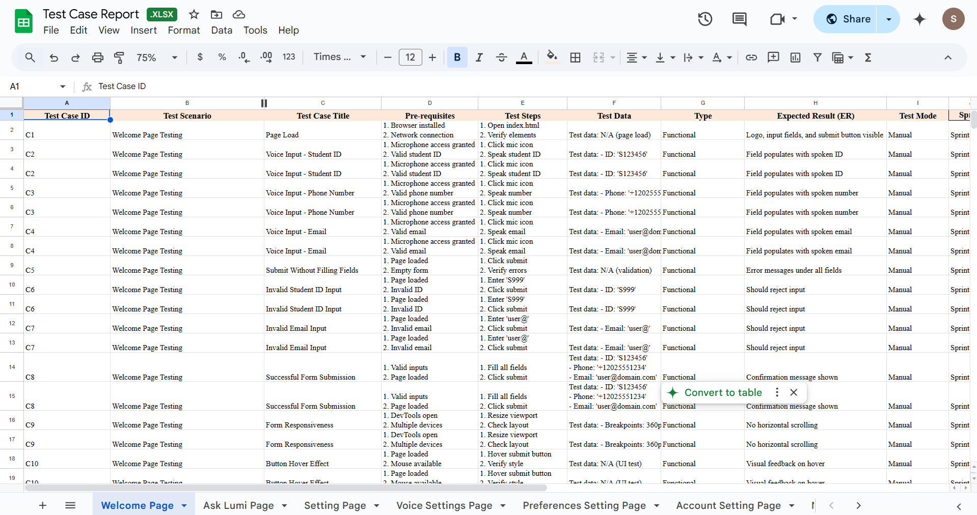
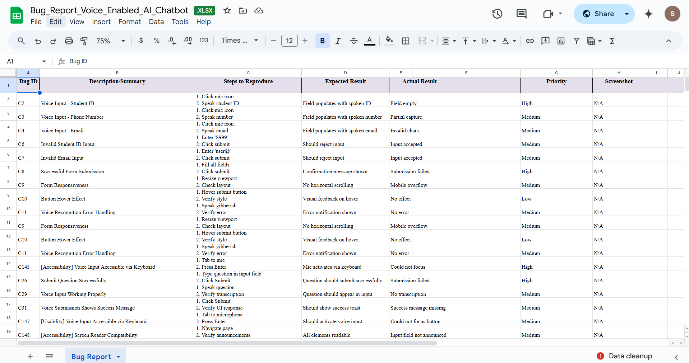

Test Case Report
Test Report: https://drive.google.com/drive/folders/1AshX_VE1_nswa40QP7ejbNJPe4hfbRwE?usp=drive_link

Slide 20
Automation Integration With Jest
Use `jest-testrail` or custom reporter
01
After Jest test execution, push results to TestRail
02
Benefits: single view of all tests, automated tracking
03

Slide 21
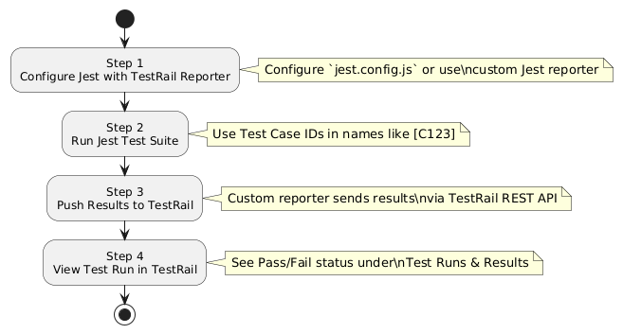
Jest → TestRail Automation Flow
jest.config.js or testrail.config.js File
Terminal Output After Jest Test Run
Test Case Naming with Case IDs
TestRail Run View After Automation Push

Slide 22
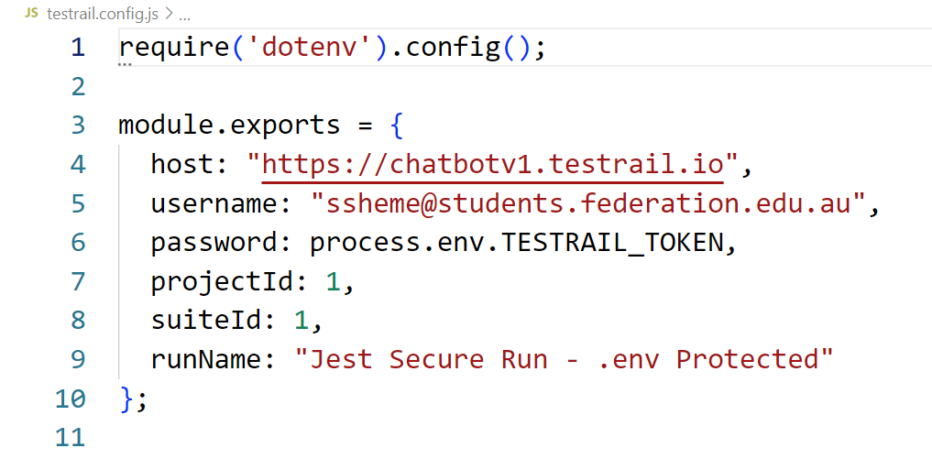
testrail.config.js File

Slide 23
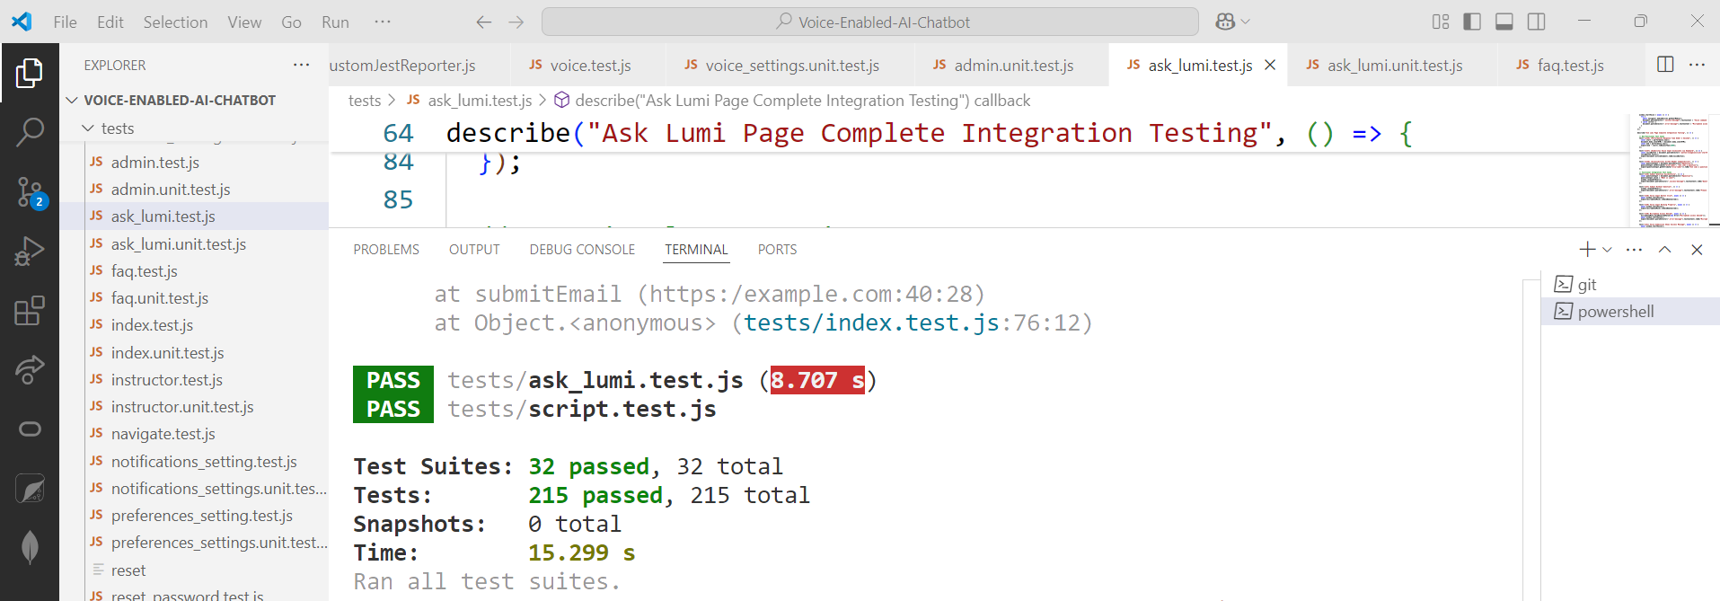
Terminal Output

Slide 24
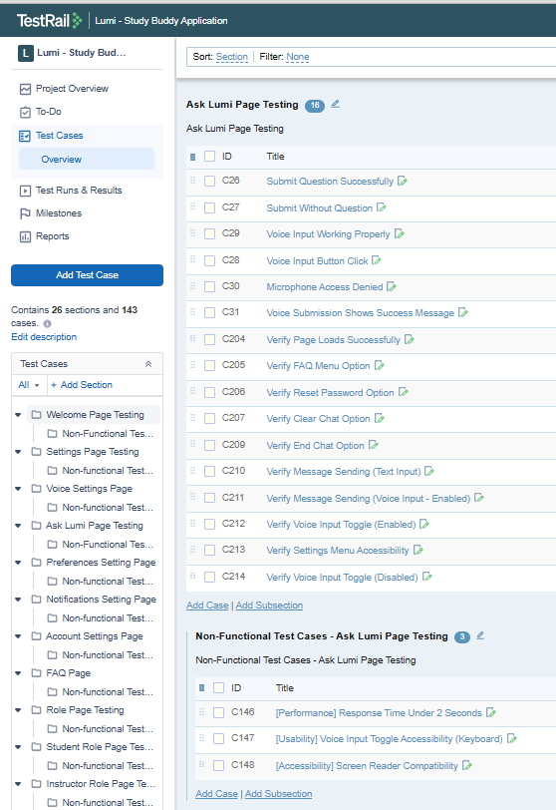
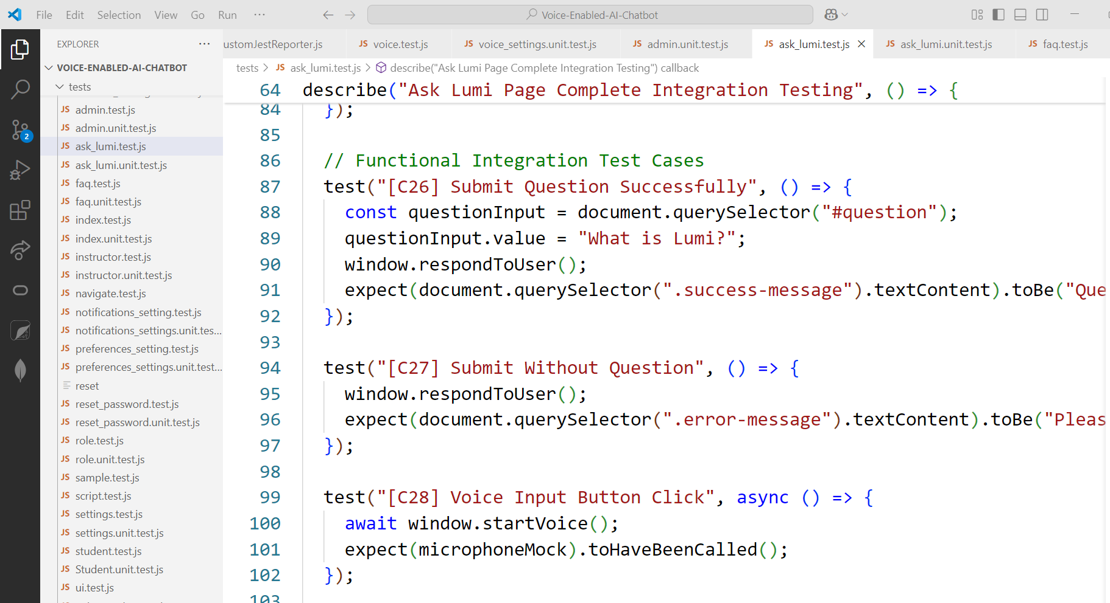
Test Case Naming With Case Ids

Slide 25
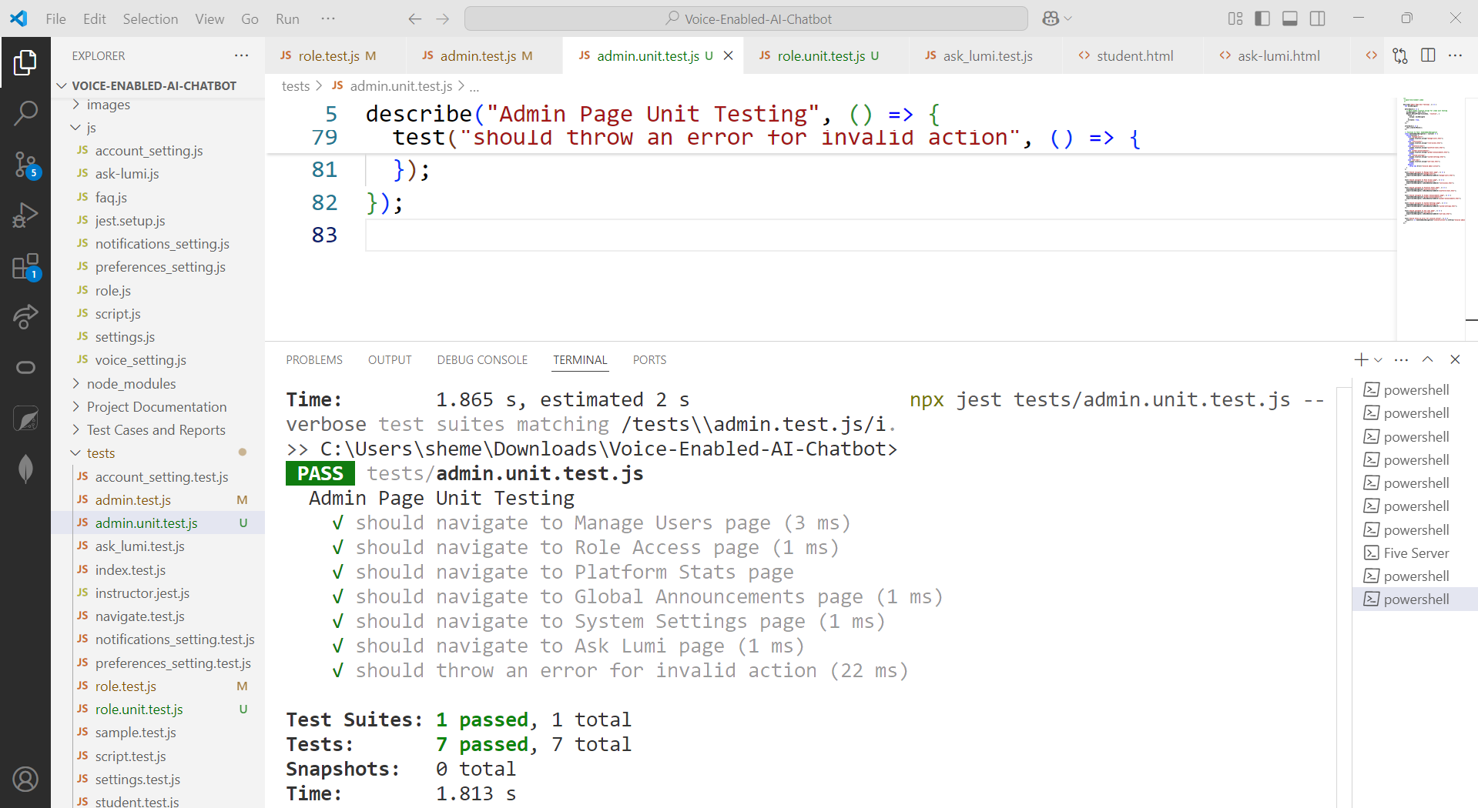
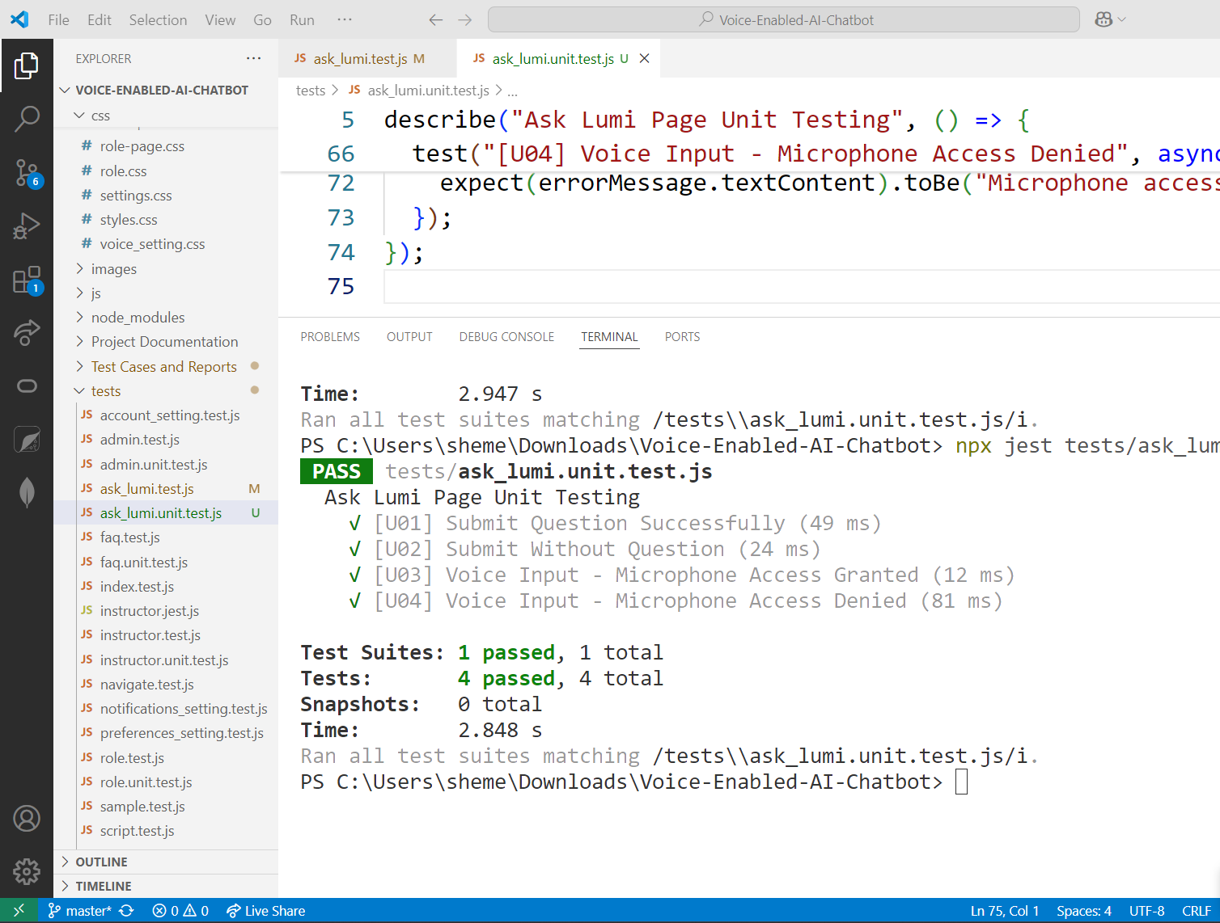
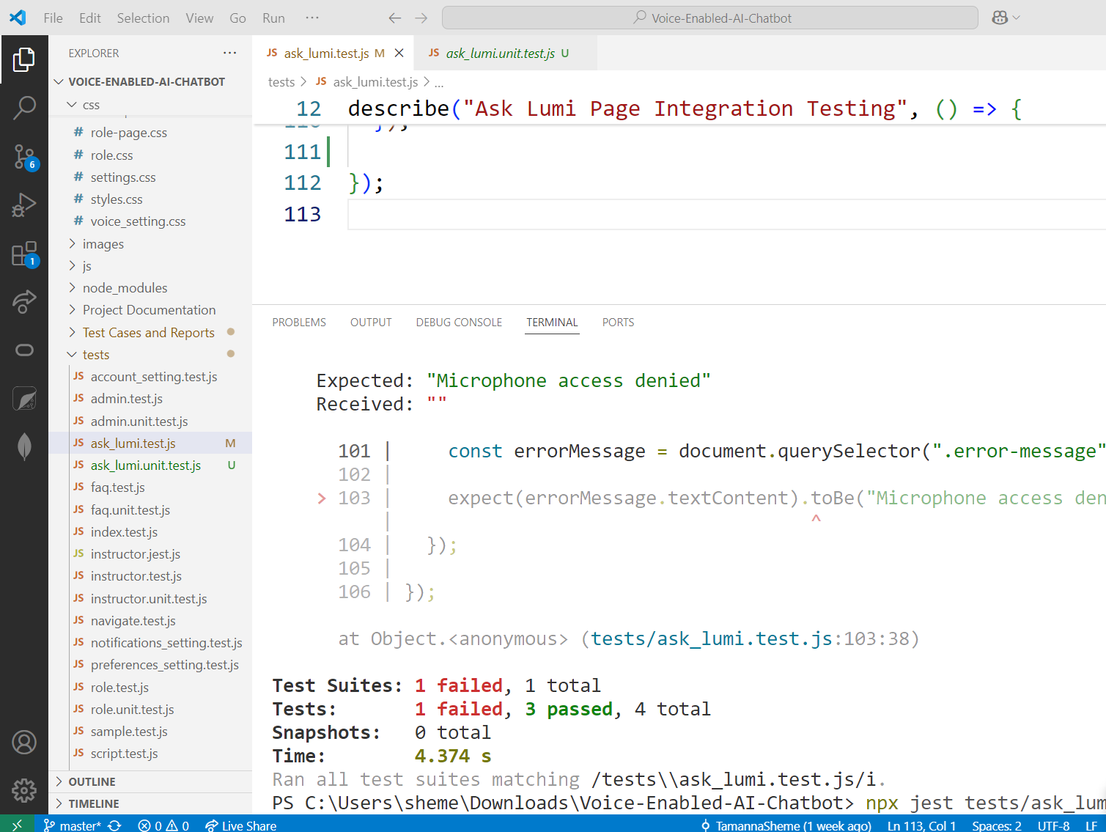
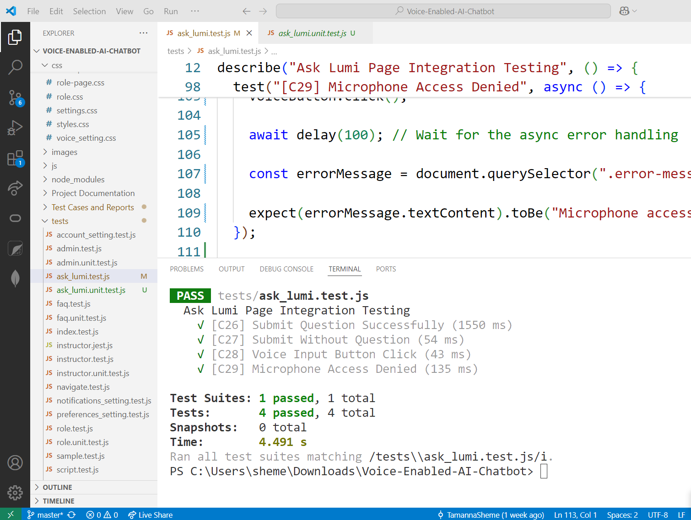
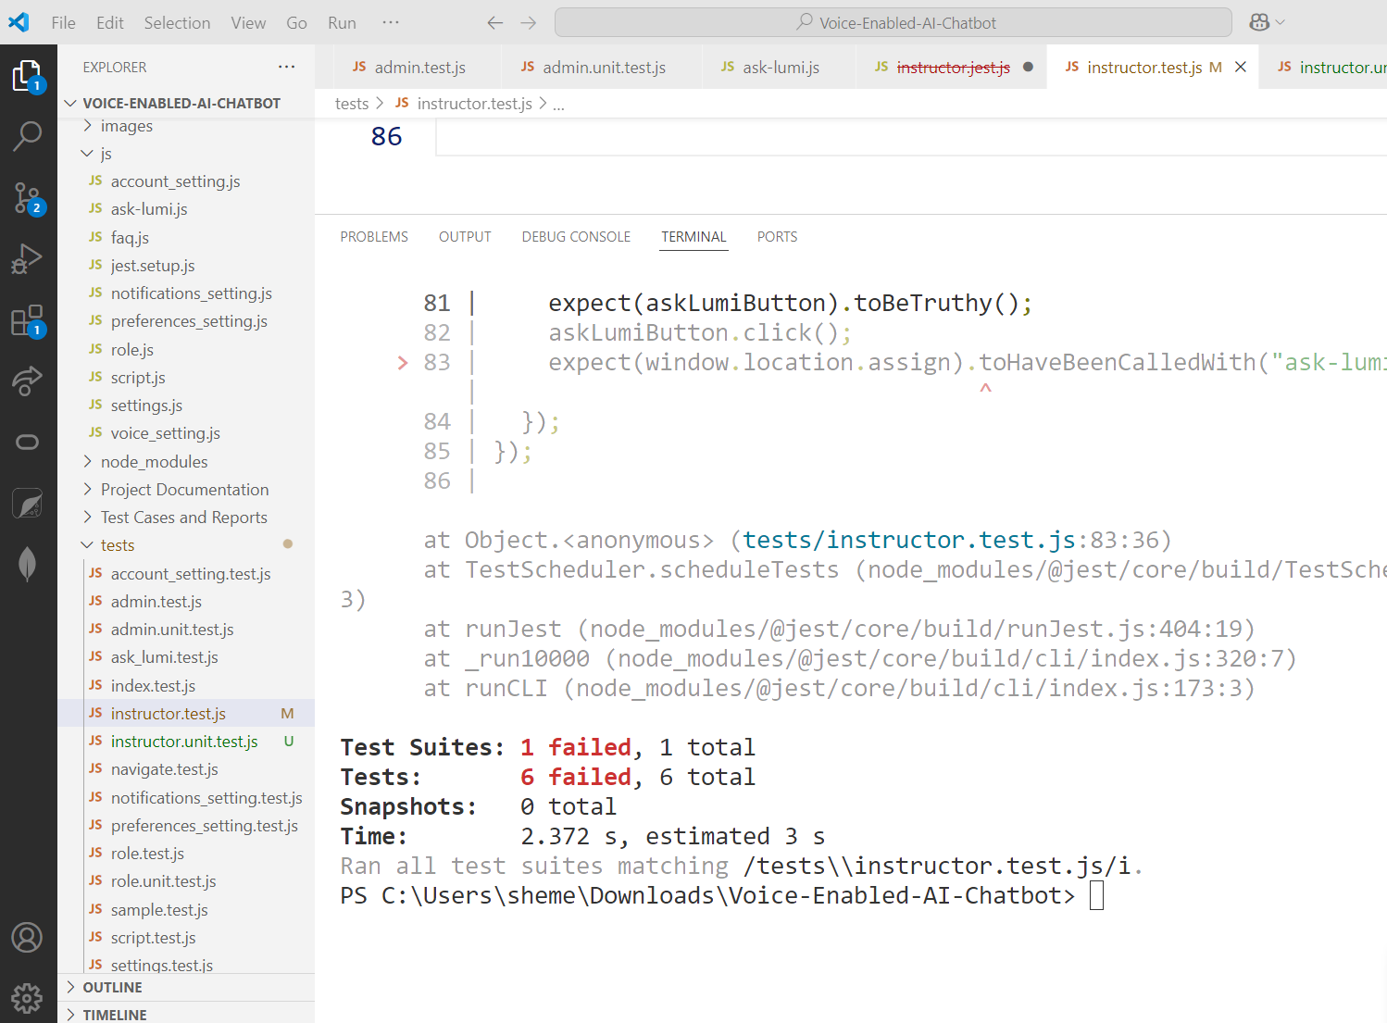
Test Run Results

Slide 26
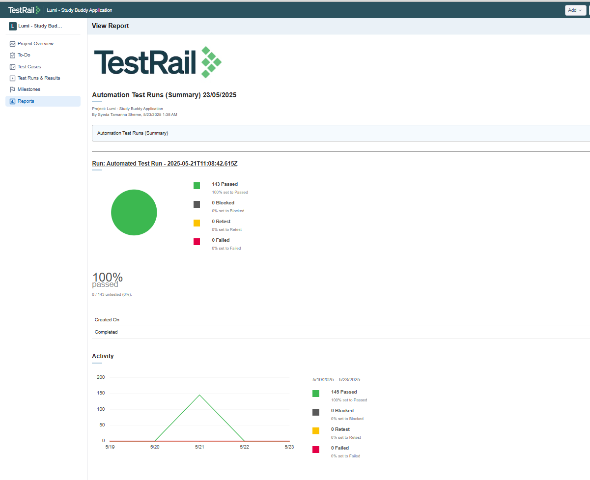
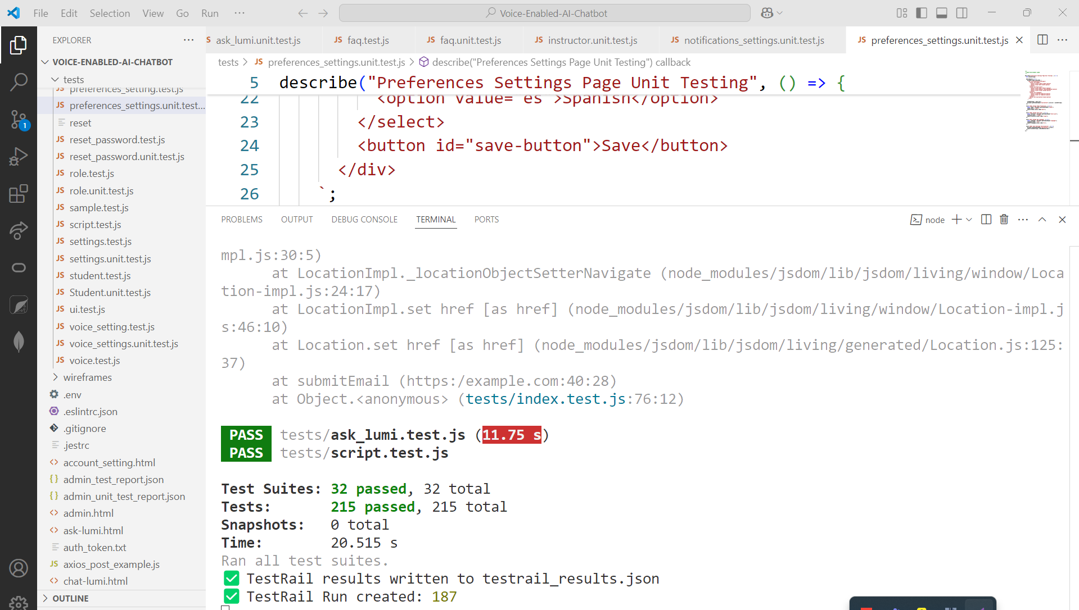
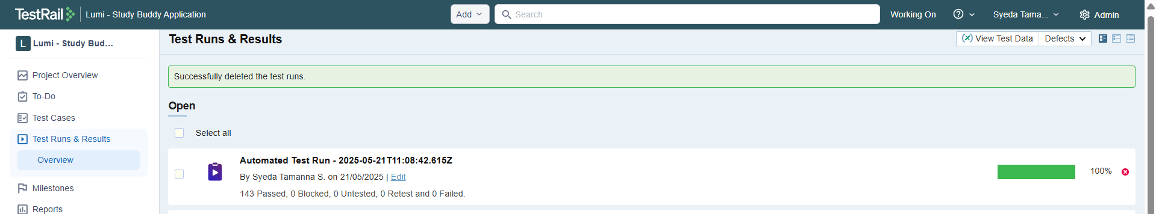
Test Cases Passed
Automation Test Run Report: https://drive.google.com/file/d/1CEPNJyByFLky1uS3r3OpZctw9Jxb6bGL/view?usp=drive_link

Slide 27
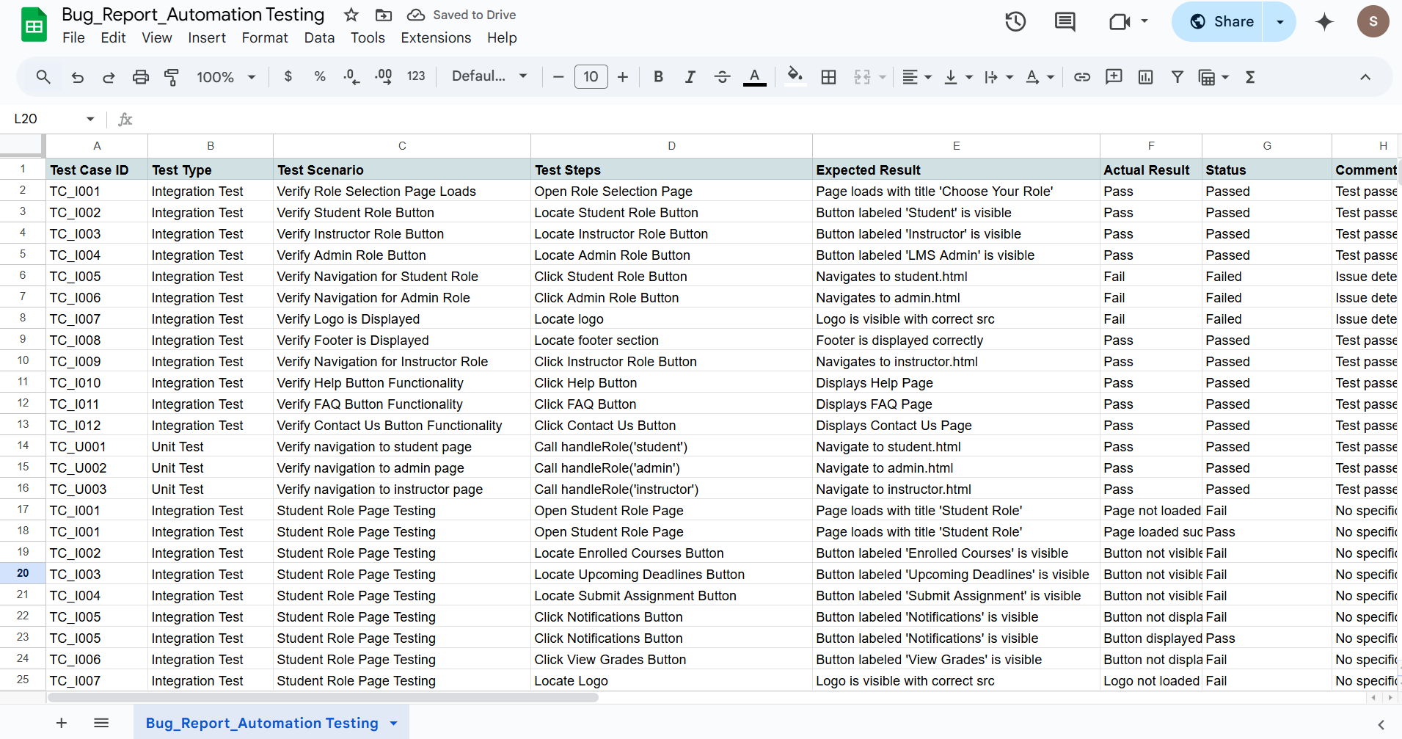
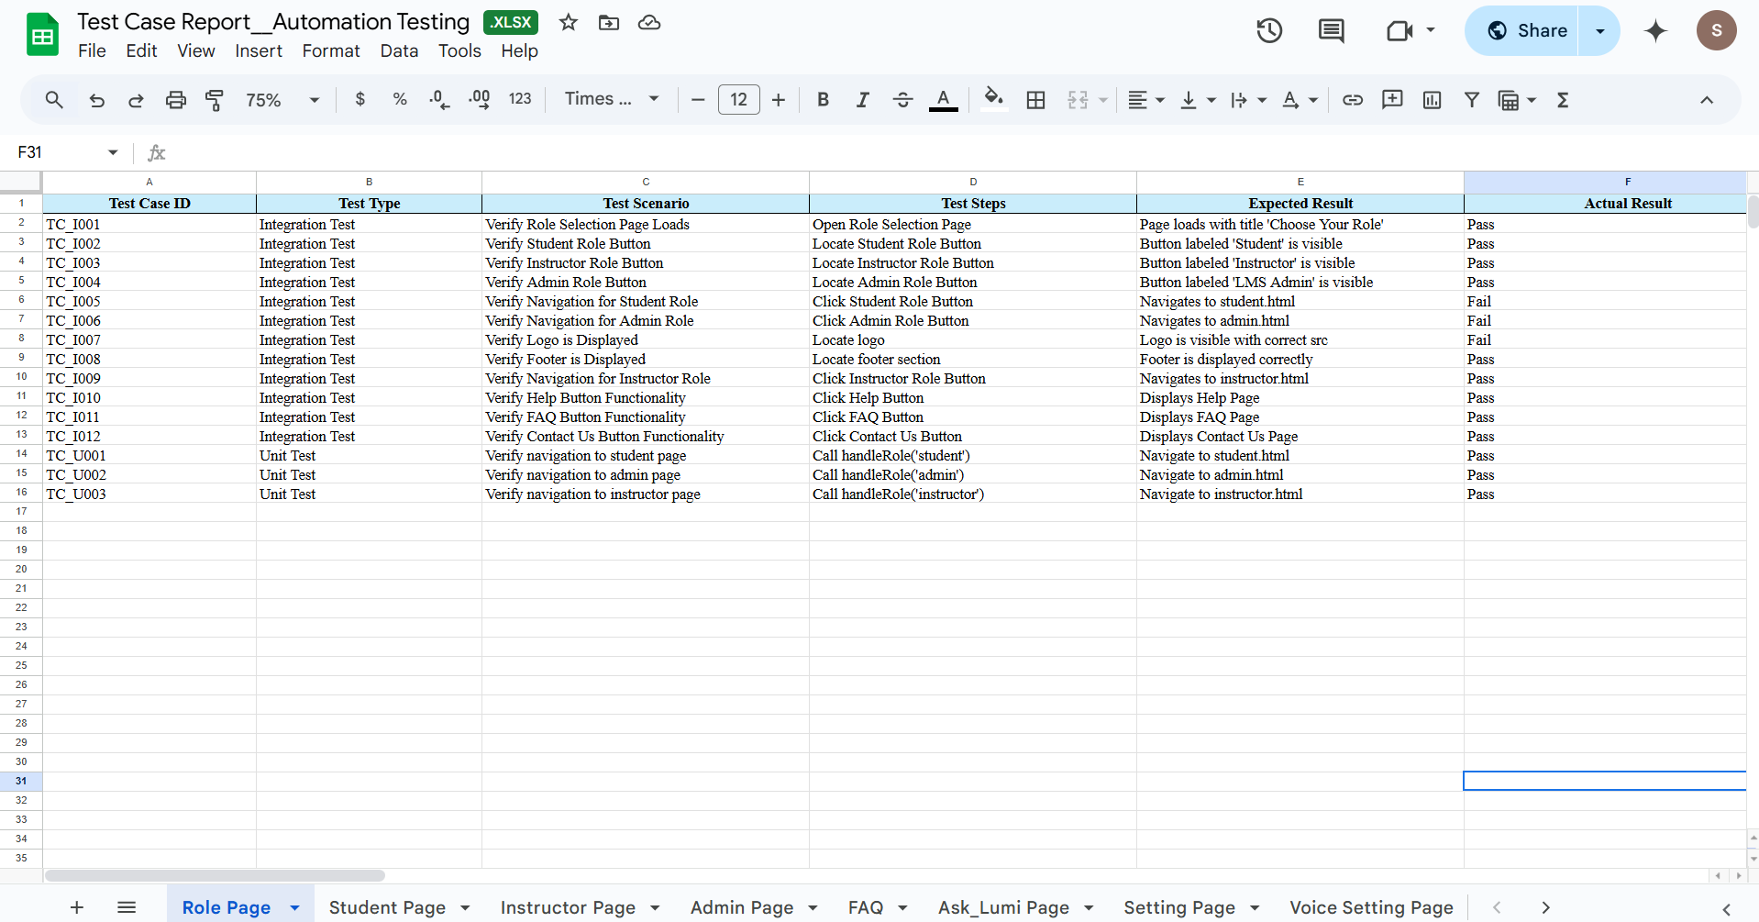
Test Case Report
Test Report: https://drive.google.com/drive/folders/1OFDHtE6gZ0YCyiwoQm4nAx5vIUQhM6wH?usp=sharing

Slide 28

All Test Runs

Slide 29
Jira Integration
Enable in
Enable in Admin > Integration
Link
Link Test Cases to Jira issues via Reference field (e.g., Scrum-191)
Create
Create Jira issues directly from failed test cases
Track
Track issue status from within TestRail

Slide 30

Jira Integration

Slide 31

Jira Connected With Test Rail

Slide 32

Custom Automation Integration with Jest, TestRail, and Jira
customJestReporter.js handles result upload after Jest test execution.
Test results are extracted and formatted with associated TestRail Case IDs.
Results are posted to TestRail via REST API (add_run, add_results_for_cases).
If a Jira key is tagged (e.g., [SCRUM-101]), test outcome comments are auto-posted to Jira.
Uses environment-secured credentials from .env (testrail.config.js supports .env protection).

Slide 33

customJestReporter.js

Slide 34

Reporting In TestRail

Slide 35



Test Rail Report
Test Rail Report: https://drive.google.com/drive/folders/12VatPyN-9Oqc2DipI8viFHERUdzO1-G9?usp=sharing

Slide 36
Jira Connected with Test Rail

Slide 37

Manual and Automated Testing Workflow

Slide 38

🚀 Visual Studio Code & GitHub Excellence 🌐
Visual Studio Code Setup:
Configured VS Code with necessary extensions for efficient coding.
Set up formatting, linting, and debugging tools for consistent code quality.
Organized project structure for seamless development.
GitHub Management:
Maintained version control using Git and GitHub.
Regularly committed code with clear messages.
Managed branches for feature development and bug fixes.
Resolved merge conflicts efficiently.
Documented project progress and updates in the GitHub repository.
Reference: https://media.licdn.com/dms/image/v2/D4E22AQGsIBCmGAbm-g/feedshare-shrink_800/B4EZb827G0GUAk-/0/1747998982911?e=1750896000&v=beta&t=bj-VQI43nEg-bw4YAh8JVxCzVzIxONCAAbyKL_c3v3c

Slide 39


Maintained Visual Studio Code & GitHub

Slide 40
Accomplishments (Sprint Summary)
Sprint 1: Planning & Prototype
🎨 Designed wireframes using Figma
🧩 Developed initial UI structure
🎙️ Implemented voice toggle feature
Sprint 2: Development & Testing
💻 Completed 13 frontend pages
🔗 Integrated TestRail–Jira workflow
🧪 Performed manual and automated testing using Jest
Sprint 3: Finalization & Delivery
🎯 Finalized all UI and test components
🐞 Logged & resolved bugs
📄 Delivered documentation
🤝 Submitted project to client with demo

Slide 41
Stream Knowledge Application
💻 Frontend Development:
HTML5, CSS3, Bootstrap, JavaScript
Built responsive, accessible UI components
🧪 UI Automation Testing:
Implemented test suites using Jest
Validated user interactions and UI logic
📝 Test Management with TestRail:
Created, executed, and tracked test cases
Generated detailed test run reports
🔄 Agile Collaboration:
Used Jira for sprint and issue tracking
Documented progress and decisions in Confluence

Slide 42
Key Learnings
🎨 Figma for UI/UX Design
Learned to design and structure wireframes for multiple frontend components
Converted static mockups into responsive interfaces
💻 Frontend Development
Translated Figma wireframes into live, interactive UI using HTML, CSS, and JavaScript
🧪 Comprehensive Testing
Performed manual testing across all frontend pages
Wrote and executed automated tests using Jest
📋 Test Management Proficiency
Created test cases and managed executions in TestRail
Integrated TestRail with Jira for efficient bug tracking
🔁 Agile Teamwork
Participated in backlog grooming, sprint reviews, and collaborative stand-ups using Agile methodology

Slide 43
What I Overcame and What I Learned
Backend-Frontend Sync Issues
- Faced API mismatches and data structure misalignment during early integration phases
Incomplete Test Coverage
- Initial automated tests missed a few edge cases, requiring rework later
Accessibility Enhancements Delayed
- Limited time prevented full implementation of advanced accessibility features
Tool Limitations
- Faced repository conflicts during GitHub collaboration
- Ran out of execution slots in TestRail’s free version, affecting test run scheduling

Slide 44

Client Feedback
Appreciated the team’s exceptional documentation, testing, and overall project execution—well above average compared to other teams.
Praised the clarity and confidence in the final presentation, noting strong collaboration and structured effort.
Rated the project 8 out of 10, reflecting high professionalism and technical competence.
Acknowledged that the team delivered beyond expectations, completing all parts including technical and documentation.
Highlighted that, despite overseeing many similar projects, this level of thoroughness stood out.
Described the final outcome as “great”, recognizing the quality and dedication shown throughout.

Slide 45
Final Deliverables
Project Code Repository
UI/UX Wireframes
Testing Artifacts
Documentation
Promo Video

Slide 46
Final Thoughts & Reflections
Built a functional voice-enabled AI chatbot for Moodle
Delivered role-based interaction with student and instructor support
Applied skills in frontend, testing, and API integration
Produced key deliverables: code, tests, documentation, and demo video
Improved teamwork, problem-solving, and agile collaboration

Slide 47

🙏 Thank You for Your Time!
👤 Presented By: Syeda Tamanna Sheme
💻 Role: Frontend Developer & QA Tester
📨 It was a pleasure working on this project. Feel free to connect!
🔗 LinkedIn 🐙 GitHub

